Slide 1
FACE RECOGNITION HOME SECURITY SYSTEM
Course No : CSE 3200
Course Title : System Development Project
Presented By: Supervised By: Sourav Mandol Dr. Sk. Mohammad Masudul Ahsan 1607044 Professor, Department of Computer Science and Engineering Sumon Mia KUET 1607045

Slide 2
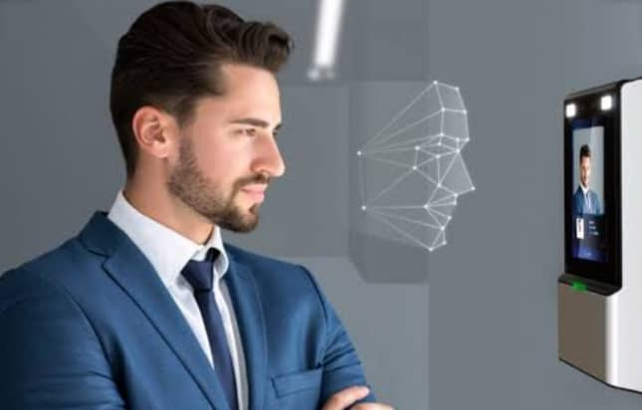
Introduction
Face recognition is a biometric technology. It goes beyond just detecting and recognizing human faces in an image or video.

Slide 3
Objectives
Developing an security system based on face recognition.
Ensuring security with user friendly interface.
Developing an IOT based project platform.
Detecting known faces after training the images.
Minimizing the process of retraining the machine.
To digitalize Home and Office.
Image acquisition.

Slide 4




Problem Statement
Provide more security
Identify a person’s face
Digitalize Home
Liveness Detection

Slide 5
Technical Part
Designing Process
Detecting faces from haarcascade method.
Recognizing faces from encodings.pickle.
Compute 128-d face embeddings to quantify a face and stored points in encodings.pickle file.
Train a Support Vector Machine (SVM) on based on the embeddings points.
Detecting faces’ liveness and recognizing faces in images and video streams.
All of these tasks will be accomplished with OpenCV, enabling haar cascade method with integrated face_recognition_library.

Slide 6
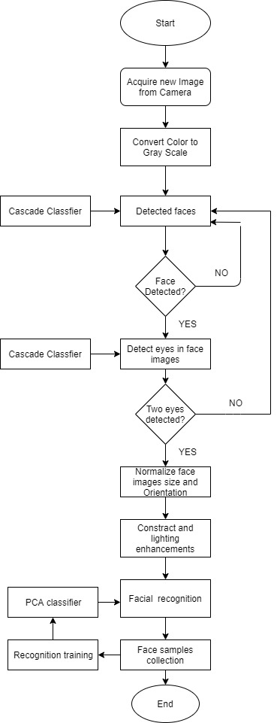
Designing Process: Activity Diagram

Slide 7
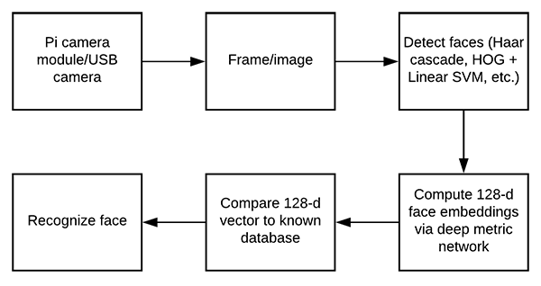
Face Recognition Embedding

Slide 8

System User Overview
Face Recognition Home Security System basically has some modules for proper functioning .
Admin - who has right for
Normal users and strangers can use observe and capturing facilities.
For new user, system have some instructions in help section.
Create new member
Rename member
Remove member
Change password

Slide 9
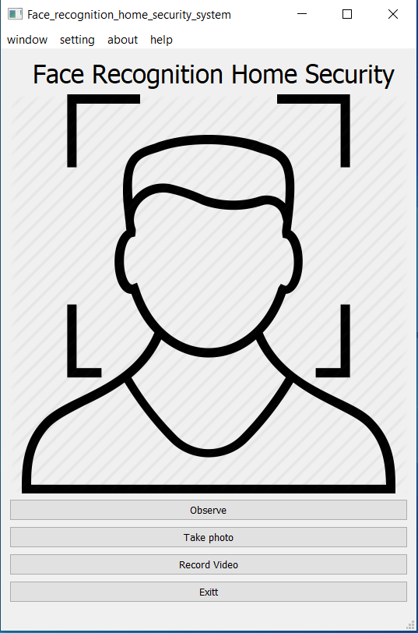

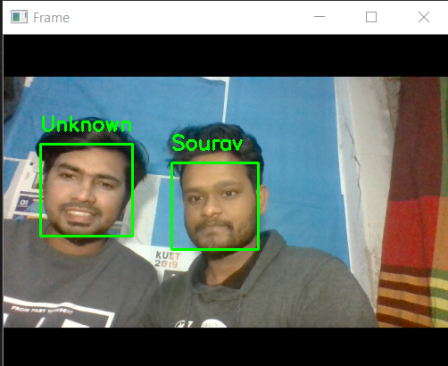
Graphical User Interface
Users can go security window from home window by clicking ‘security’ from window navigation section or just using ‘Ctrl +S’.

Slide 10
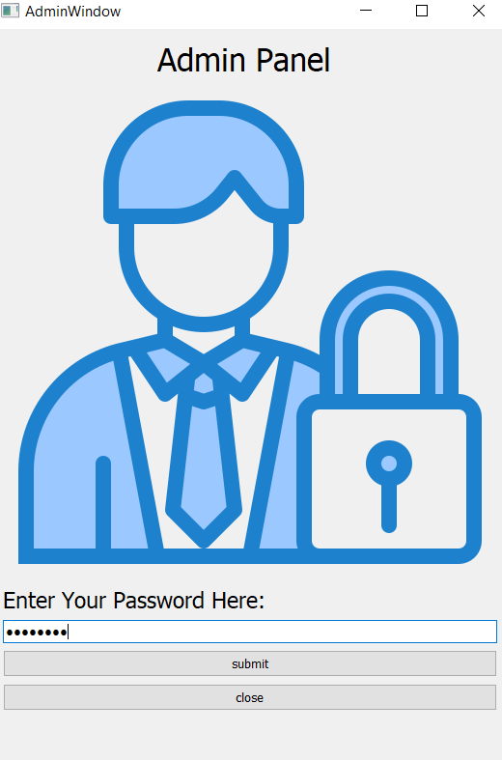

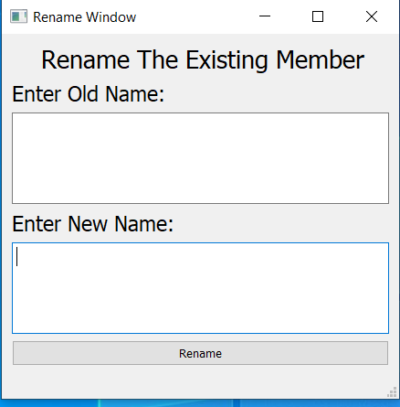
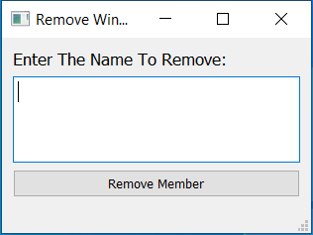
Graphical User Interface
User can go admin window to home panel by clicking ‘admin’ from window navigation
section or just using ‘Ctrl +A’.

Slide 11
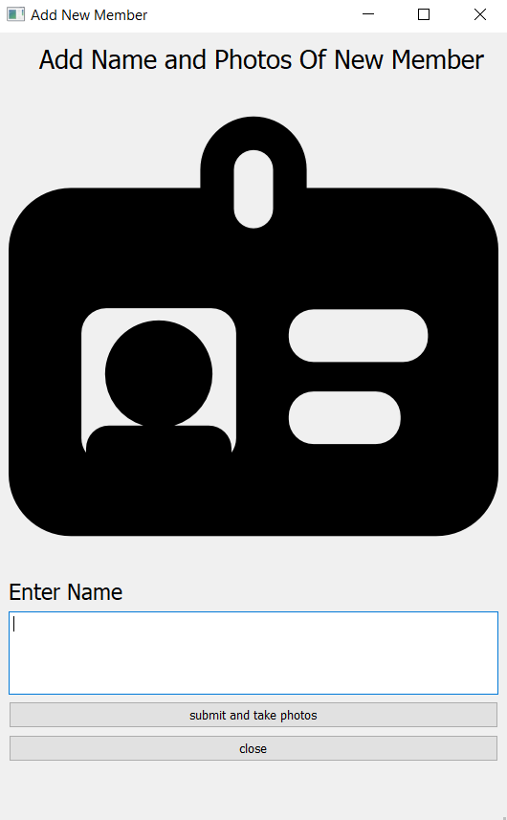
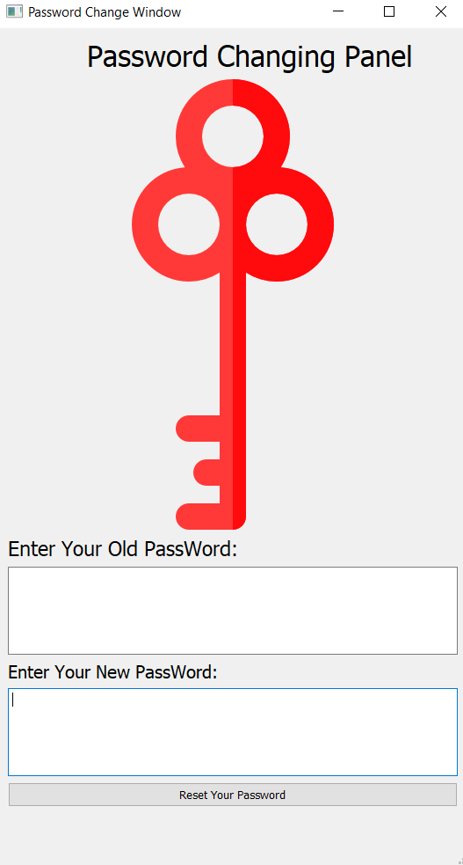
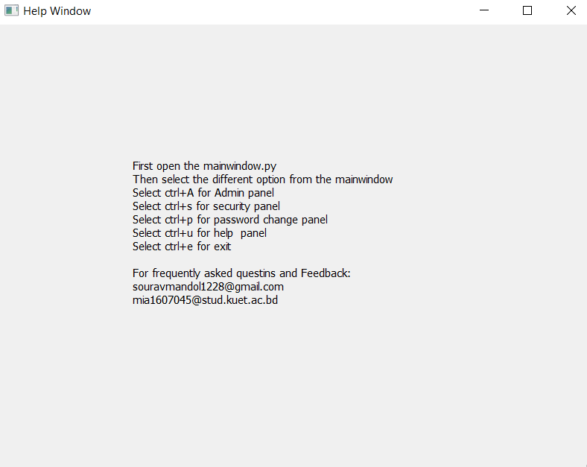
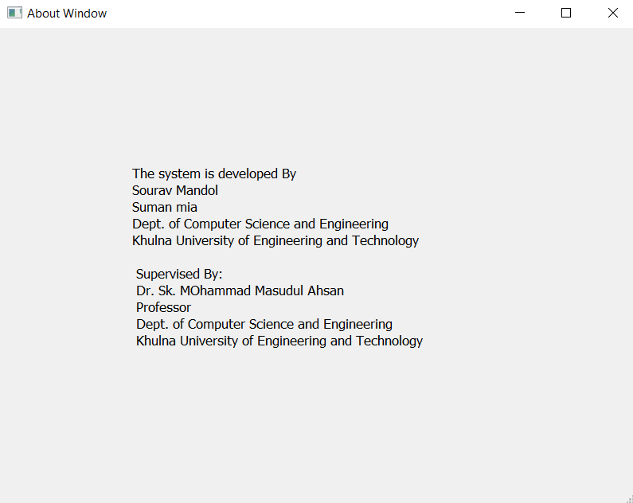
Graphical User Interface
User can change password . System provide help and about window for some instructions and helps for user.

Slide 12
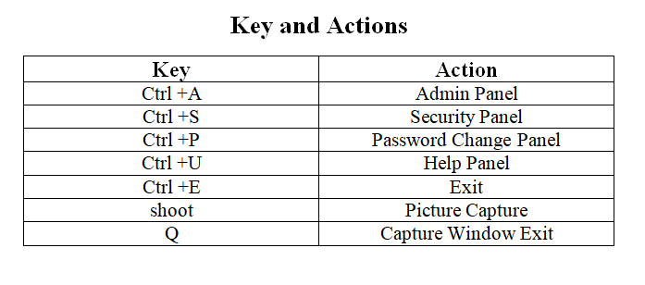
Key and Actions

Slide 13




System Features
User Friendly
Digitalize Locking System
High Accuracy Rates and Faster Processing
Reponses are easily generated

Slide 14





Challenges Faced
Recognize multiple faces
Detect both dim and bright light
Improve more accuracy and efficiency
Recognize eyeglasses person

Slide 15
Limitations
The system takes more times to detect faces in dim light.
Liveness detection isn’t as strong as system needed.
The system is slow to recognize an eyeglasses person.

Slide 16
Future Development
In future, this system will be more fast and efficient.
Liveness detection will be accurate and perfectly recognize real or fake person.
Eyeglasses people will be easily recognized.
In every light combination, the system will able to recognize person’s face accurately.

Slide 17
Learning Outcomes
How to make a gui with python(pyqt5 designer)
How to detect faces from a frame
How to recognize faces from trained dataset
How to detect liveness of an image
How to make project connecting hardware and software

Slide 18
Associative Courses:
CSE 1102: Computer Basics & Programming Laboratory
CSE 2101: Data Structures & Algorithms
CSE 3119: Software Engineering & Information System
CSE 3104: Peripheral and Interfacing Laboratory

Slide 19
Conclusion
The Face Recognition Home Security System is developed using opencv, face recognition library and deep learning which fully meets the objectives of the system. The system has reached a steady state where all bugs have been eliminated. The system is operated at a high level of efficiency and all the user associated with the system understands its advantage.

Slide 20
ACKNOWLEDGEMENT
We would like to express our profound and sincere gratitude to our project supervisor Dr. Sk. Masudul Ahsan, Professor of Department of Computer Science and Engineering, Khulna University of Engineering and Technology, Khulna for his rationale guideline, encouragement and for taking time off his busy schedule to provide invaluable input to words to complete our project. His suggestion and encouragement play a vital role in our project work.

Slide 21
THANK YOU

